Slide 1

Innovate NSUT Round 1 Hackathon Project
Delhi Rejuvenation Mission
Project Title :
Delhi AQI Predictor and ML Dataset Analysis
Team Name : Bharat Innovators
Team Member Name : Chaitanya Mangla (Individual)
College : University School of Automation and Robotics, GGSIPU (EDC)

Slide 2


Delhi Rejuvenation
Delhi Rejuvenation refers to the comprehensive government led initiatives aiming to restore the ecological, environmental and aesthetic health of the city’s natural resources and the environment, primarily focusing on air pollution, cleaning the Yamuna River, reviving the lakes and developing the green spaces.
But we all know that Air is the most basic necessity for living. Also, due to the problem of excessive Air Pollution in Delhi, the other development works and the project related to Delhi Rejuvenation gets delayed.
Hence, in my project I laid my specific stress on the problem of Excessive Air Pollution in Delhi and have built something to solve and reduce that problem which can be even used at home by common people at home, free of cost.

Slide 3


Delhi AQI Predictor
I’ve built an AQI Predictor for Delhi which is used to predict the Air Quality Index. It also tells that how the air quality is based on the AQI range.
AQI Predictor helps in predicting the state of pollution and we can get an idea to take specific steps.
Because, a problem can be taken into account and solved only when we know the root cause behind it.
Hence, this predictor, predicts the air quality index and helps us in taking steps toward solving the problems.
The prediction of air quality index tells both the local people and the government to take steps.

Slide 4


Machine Learning applied in Project
This project involves a huge amount of Machine Learning as it analyses the Delhi Weather AQI Data and make predictions based on them.
This project uses the famous Random Forest Regressor to make predictions of the AQI. Random Forest Regressor is a famous supervised ML Algorithm that uses the decision trees to predict the numerical outcomes.
The Random Forest Regressor predicts the outcome from machine learning and the data analysis.
Also, to make the project more useful for the users, a more handy Streamlit UI has been made.

Slide 5


Parameters for the Prediction
In this ML Project, the AQI Prediction has been made on 10 parameters :
1. Latitude
2. Longitude
3. Temperature
4. Humidity
5. Atmospheric Pressure measured in Millibars
6. Windspeed
7. PM 2.5
8. PM 10
9. CO
10. NO2 Level

Slide 6


Special Features in the Project
A special feature in the project is that it tells predictions based on Latitude and Longitude positions, so it can make predictions precisely and accurately.
It means that any person sitting at home, if he has all the details, then he can predict the AQI of his particular place with accuracy.
The R square Score is known as the accuracy of the score. And here the accuracy score of the model is 0.94 which means that the overall accuracy of the model is around 94% .

Slide 7


Prediction Intervals
The intervals of the predictions include :
AQI 0-50 : Excellent Air Quality
AQI 51-100 : Good Air Quality
AQI 101- 200 : Moderate Air Quality
AQI 201 – 300 : Poor Air Quality
AQI Above 300 : Severe Air Pollution
So, here these are the intervals of AQI and their respective verdicts. Here, upon the prediction of last 3 verdicts, there are various solutions given by the app to improve the air quality index which should be applied.

Slide 8

Solutions to Verdicts
Solutions for AQI 101-200 :
1. Dust Management 2. Road Cleaning 3. Control Traffic Emissions 4. Public Awareness
Solutions for AQI 201-300 :
1.Implement GRAP Stage 1 2.Restrict diesel generators 3.Enforce Dust Control
4. Encourage Electric Vehicles
Solutions for AQI Above 300 :
1.Ban unessential construction 2.Vehicle Restrictions 3.Industrial Restrictions
4.Encourage Electric Vehicles 5. Medical Support to Heart & Lung Patients

Slide 9
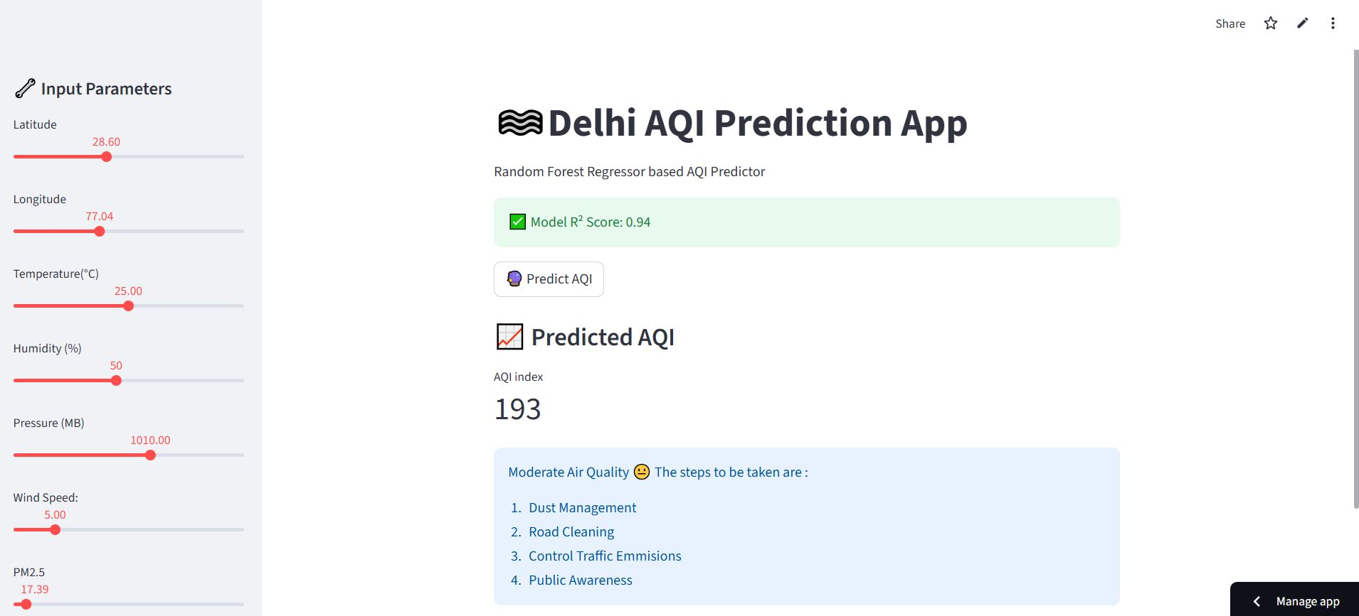
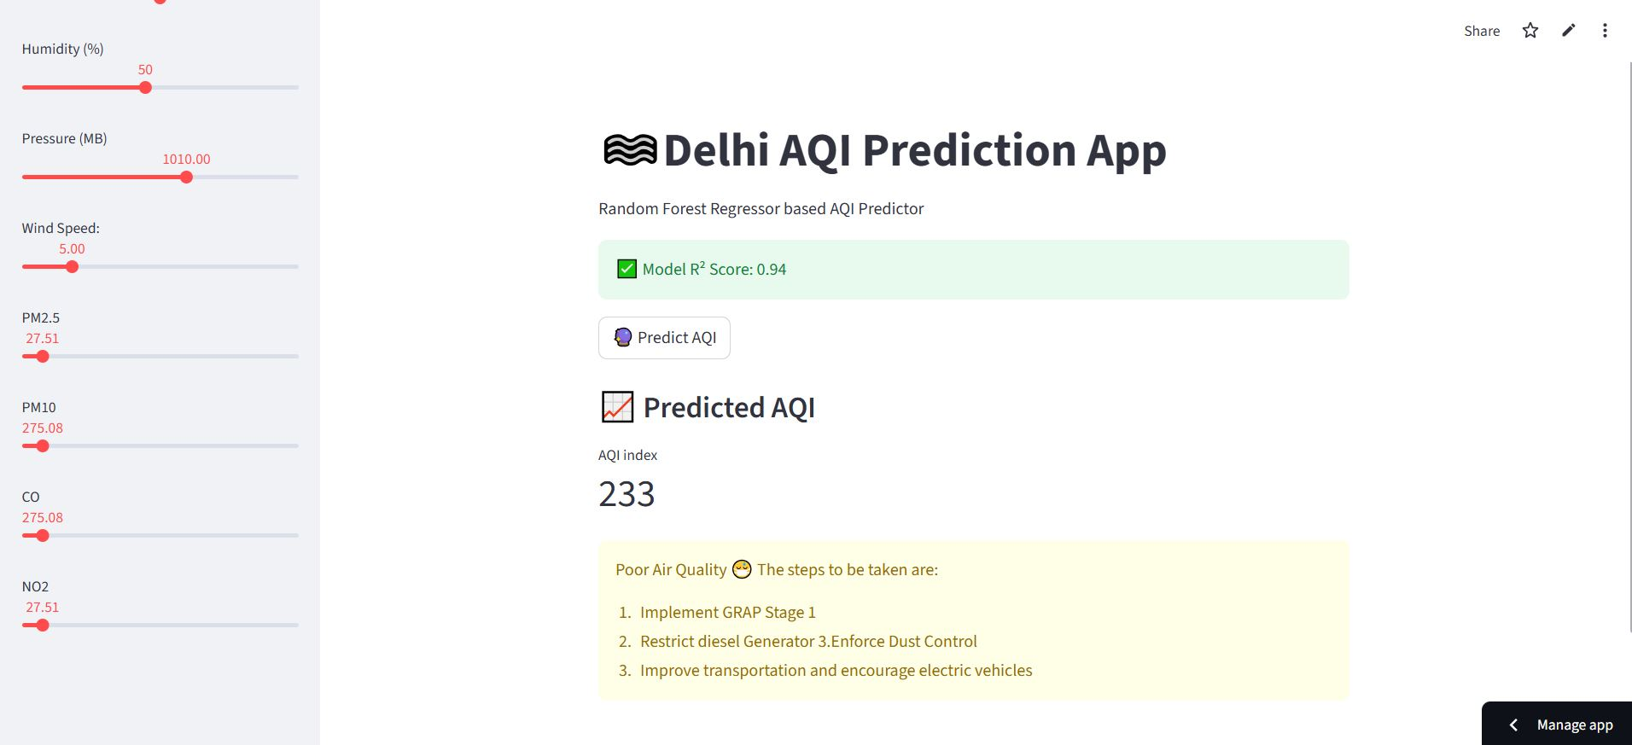
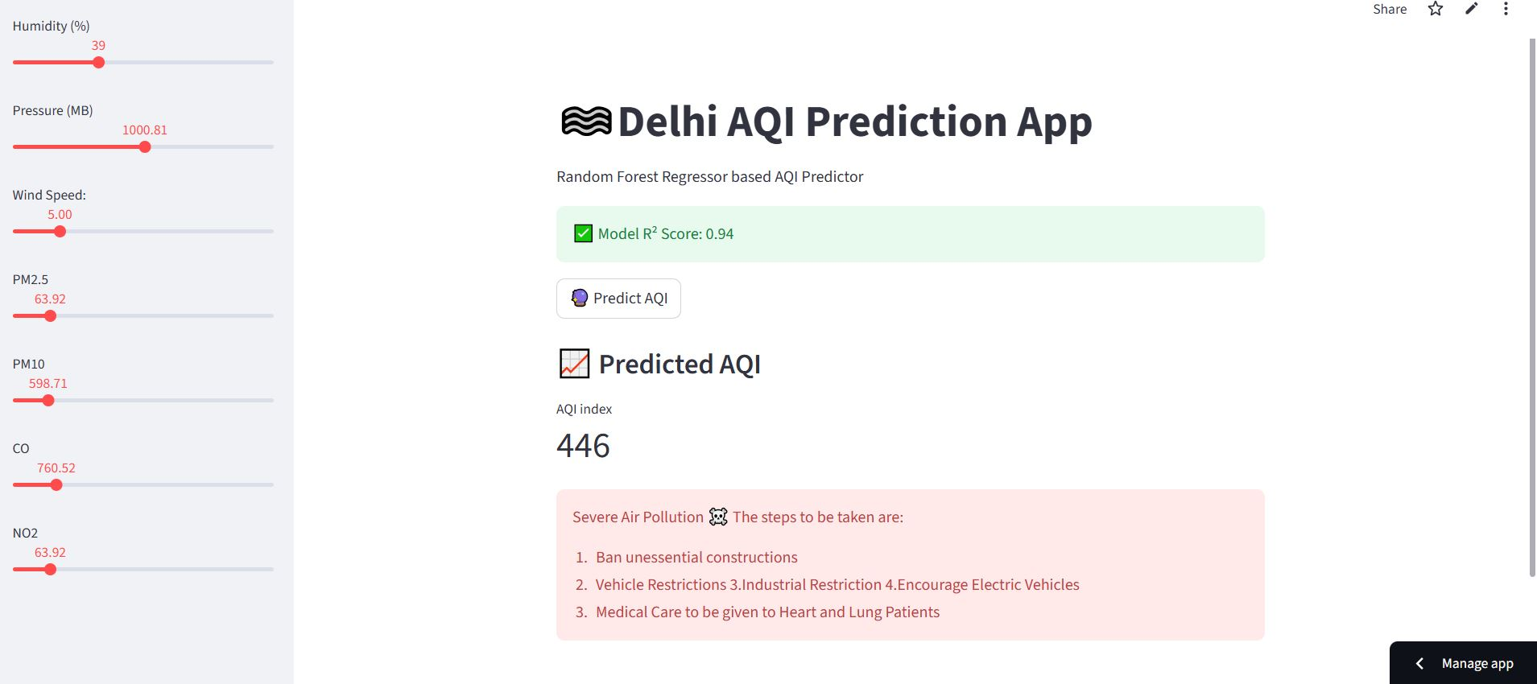
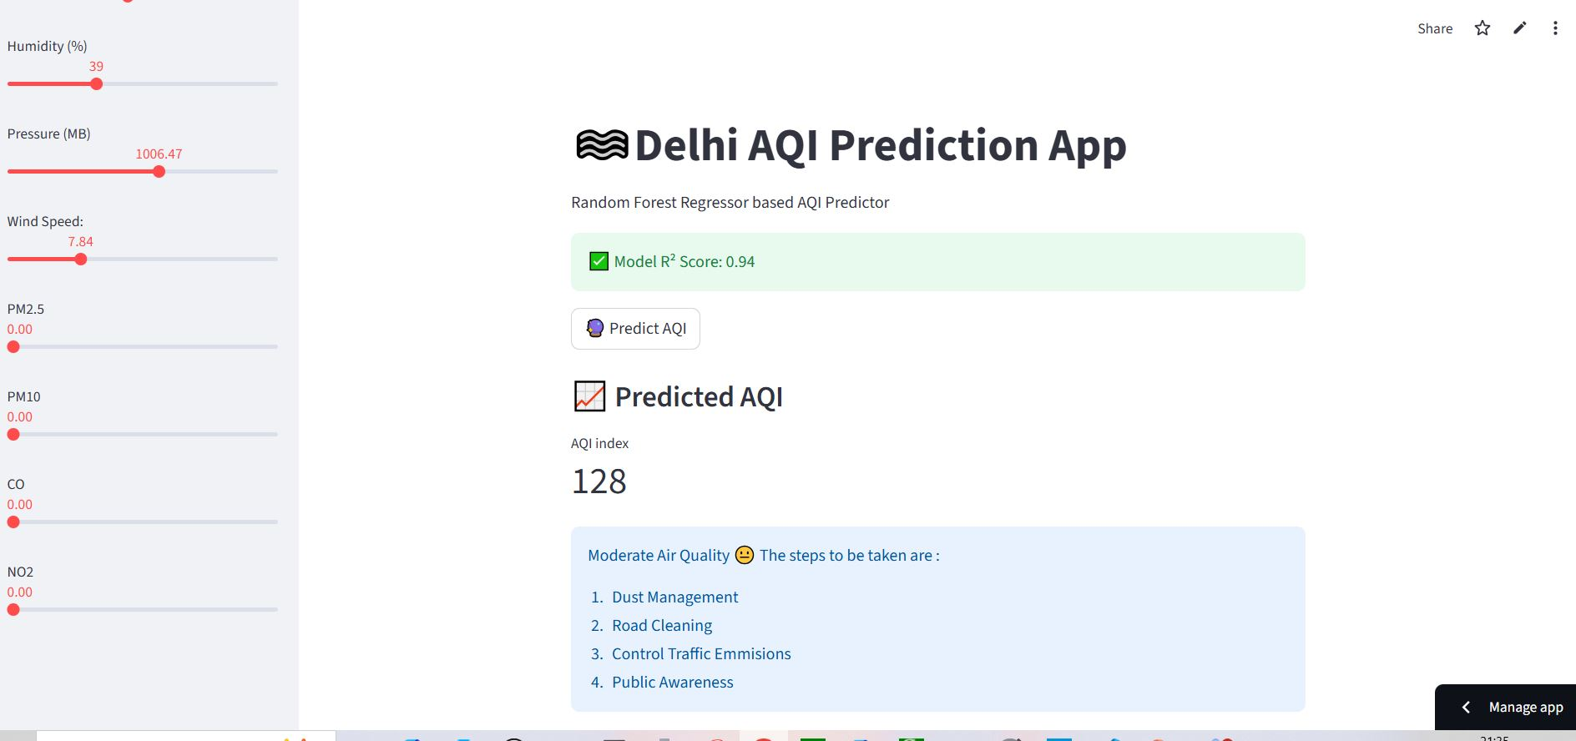
UI Screenshots

Slide 10
Project Links
GitHub Repository : Link
Streamlit UI Frontend: Link

Slide 11
Thank You
A Power Point Presentation made by Chaitanya Mangla, member of Bharat Innovators

